Slide 1
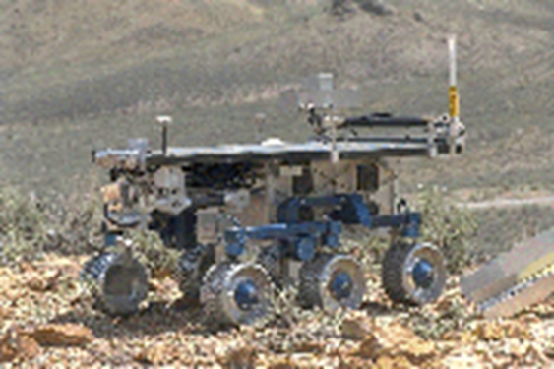
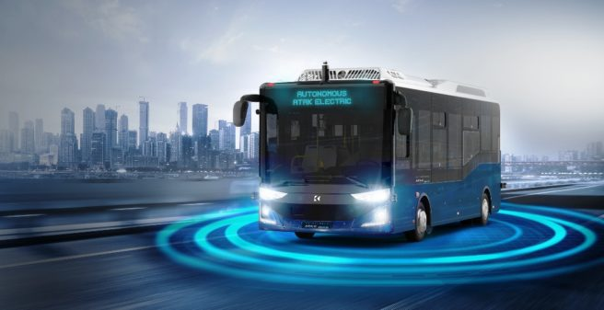

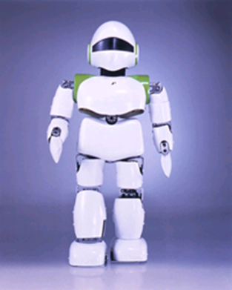
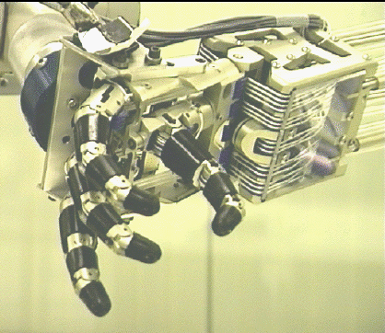
Introduction to Robotics

Slide 2
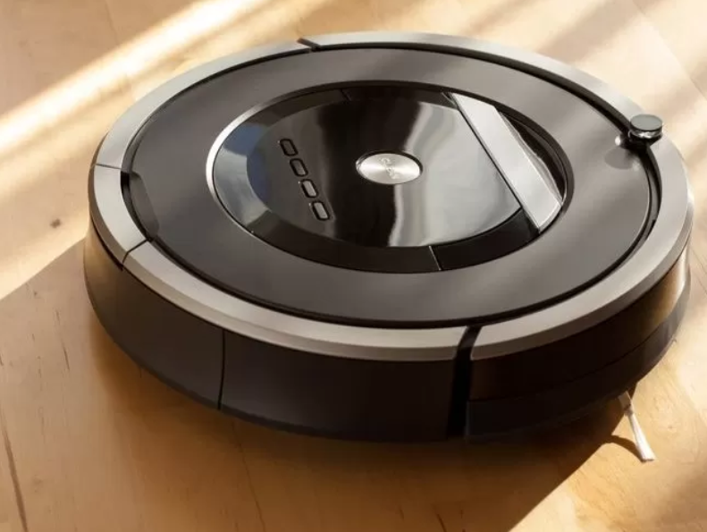
What is a robot?
Any automatically operated machine that replaces human effort.
An autonomous machine capable of sensing its environment, carrying out computations to make decisions, and performing actions in the real world.
The ideal robot should be
Reprogrammable
Multifunctional
Sensible for environment

Slide 3
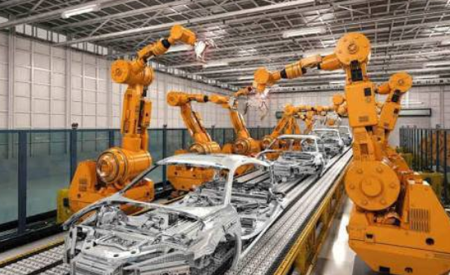
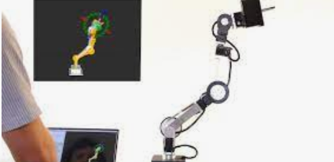
Classification of Robots
•Fixed-sequence robot: A device that performs the successive stages of a task according to a predetermined, unchanging method that is hard to modify.
•Playback robot: A human operator performs a task manually by leading the robot, which records the motions for later playback. The robot repeats the same motions according to the recorded information.

Slide 4
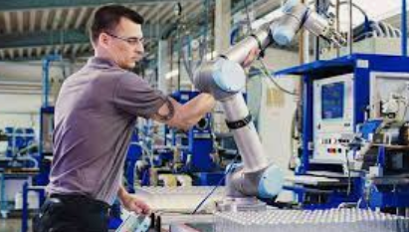
Classification of Robots
•Numerical-control robot: The operator supplies the robot with a movement program rather than teaching it the task manually.

Slide 5
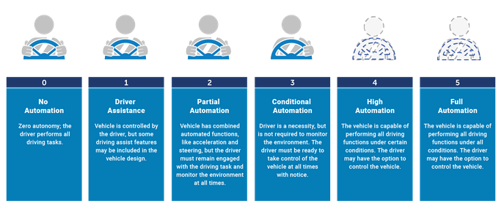
Classification of Robots
•Intelligent robot: A robot with the means to understand its environment and the ability to successfully complete a task despite changes in the surrounding conditions under which it is to be performed.

Slide 6
What is robotics?
EU says: Robotics is a technology that encompasses the design, building, implementation, and operation of robots. Robotics includes applications designed to conduct a specific task or series of tasks for commercial purposes.
My definition: Robotics is the art, knowledge base, and know-how of designing, applying, and using robots for human benefits. Robotic systems consist of not just robots, but also other devices and systems that are used together with the robots.

Slide 7
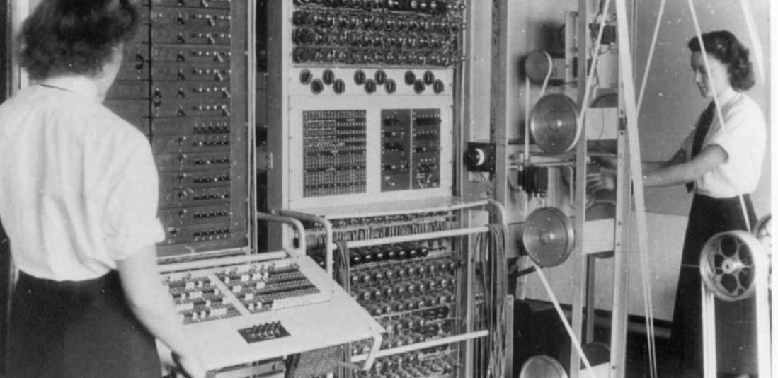

History of robotics?
1922: Czech author Karel Capek wrote a story called Rossum’s Universal Robots and introduced the word “Rabota”(meaning worker)
1954: George Devol developed the first programmable Robot.
1962: Unimation was formed, first industrial Robots appeared.
1973: Cincinnati Milacron introduced the T3 model robot, which became very popular in industry.
2010–present: Many new robots, autonomous vehicles, drones, sensors, and associated devices have appeared and have become common

Slide 8
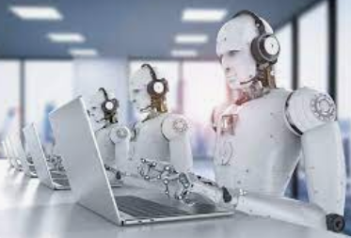
Advantages and Disadvantages of Robots
Robots can work in hazardous environments (such as radiation, darkness, hot and cold, ocean bottoms, space, and so on) without the need for life support, comfort, or concern for safety.
Robots can be much more accurate than humans.

Slide 9
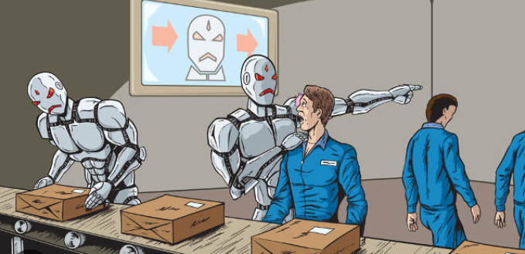
Advantages and Disadvantages of Robots
Robots, although superior in certain senses, have limited capabilities in Cognition, creativity, decision-making, and understanding.
Robots lack the capability to respond in emergencies, unless the situation is predicted.

Slide 10
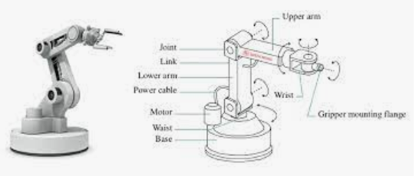
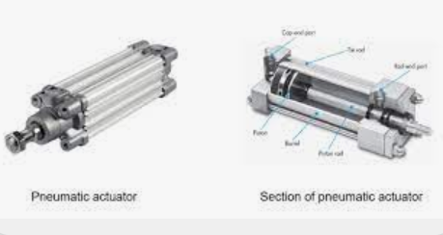
Robot Components
Manipulator/rover: This is the main body of the robot, which consists of the links, joints, and other structural elements of the robot.
Actuators: Actuators are the “muscles” of the manipulators. Common types are servomotors, stepper motors, pneumatic actuators, and hydraulic actuators.

Slide 11
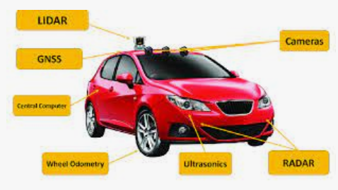
Robot Components
Sensors: Sensors are used to collect information about the internal state of the robot or to communicate with the outside environment.
Controller:The controller receives its data from the processor (the brain of the sys-
tem), controls the motions of the actuators, and coordinates the motions with the sensory feedback information

Slide 12
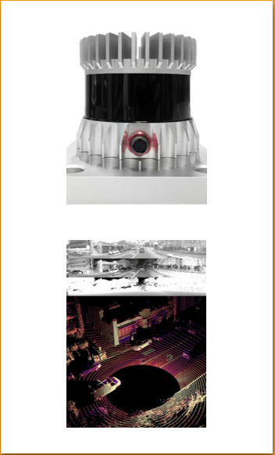
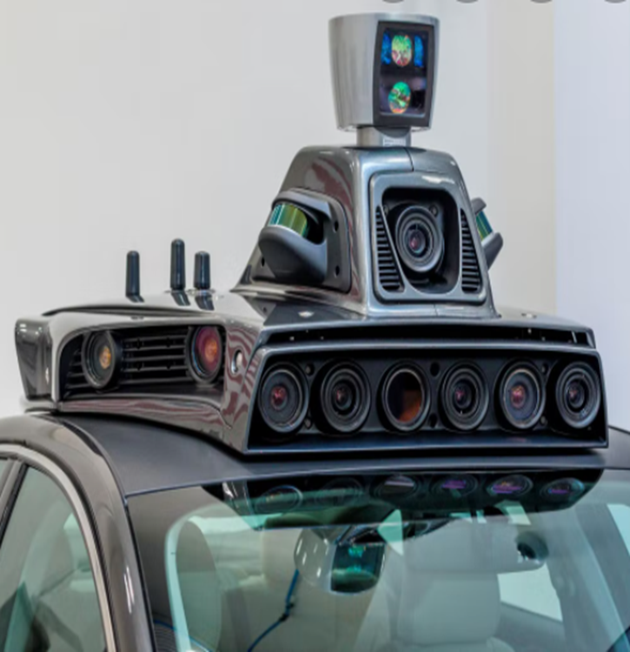
Sensors
Lidar: Object detection, environment detection with map and area matching.
Use depth
Camera: Object detection, color detection, object classification, lane information recognition.
Use depth and color

Slide 13
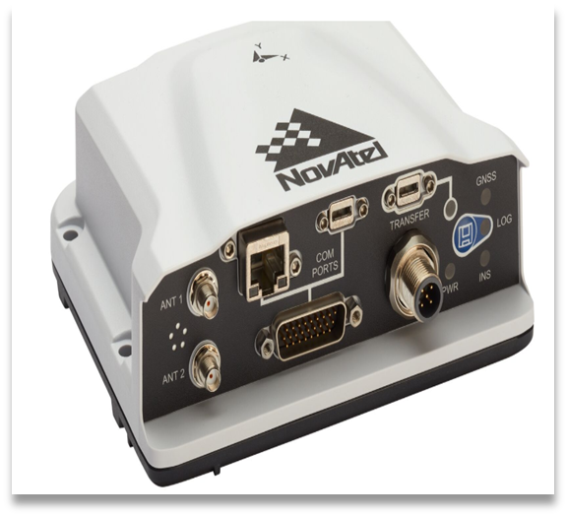
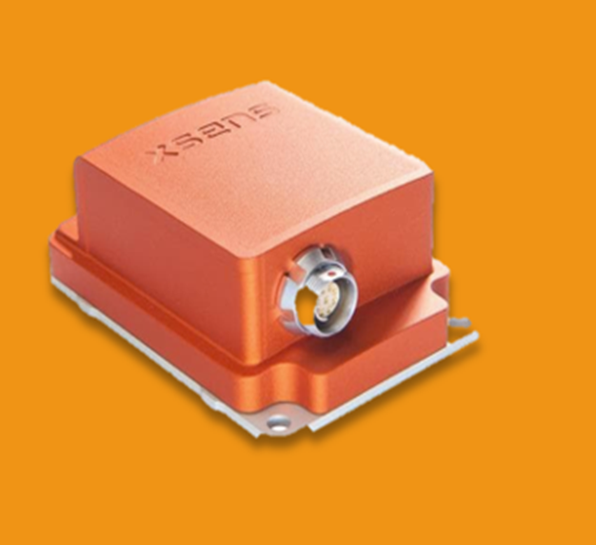
Sensors
GNSS: Localization
IMU: Acceleration, heading

Slide 14
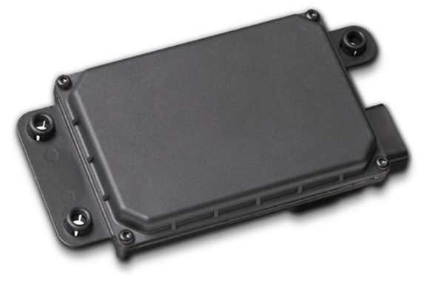
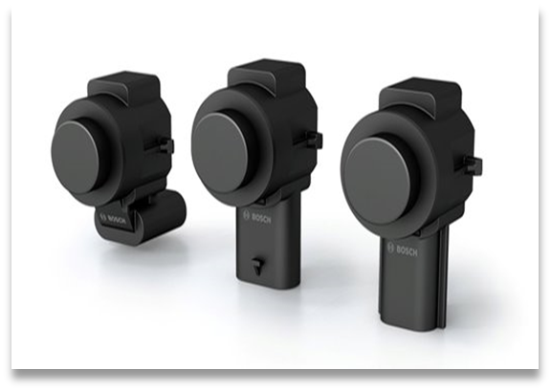
Sensors
Radar: For safety reason
Ultrasonic sensor: For small distance

Slide 15
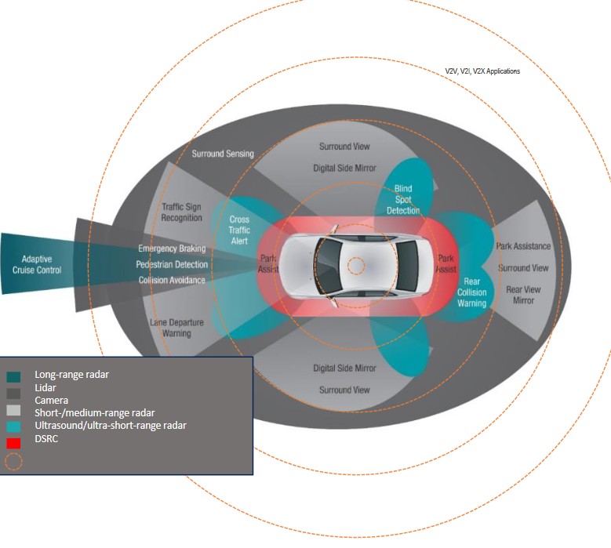
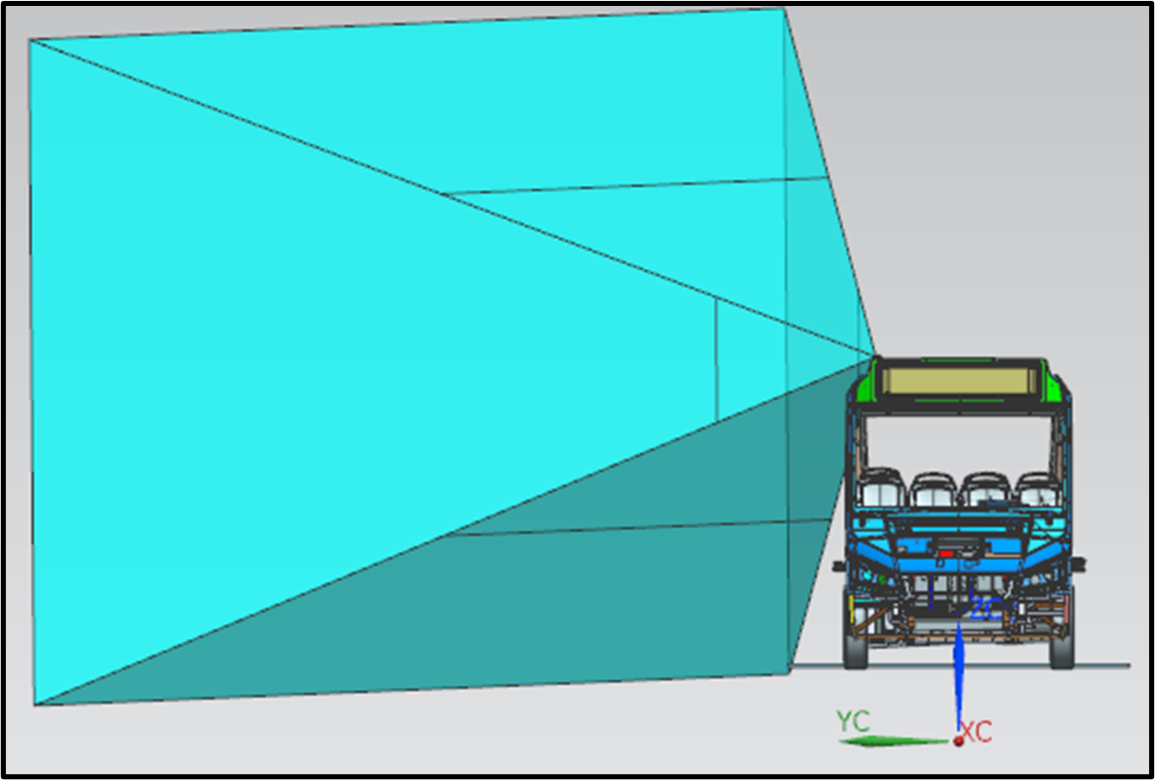

Slide 16
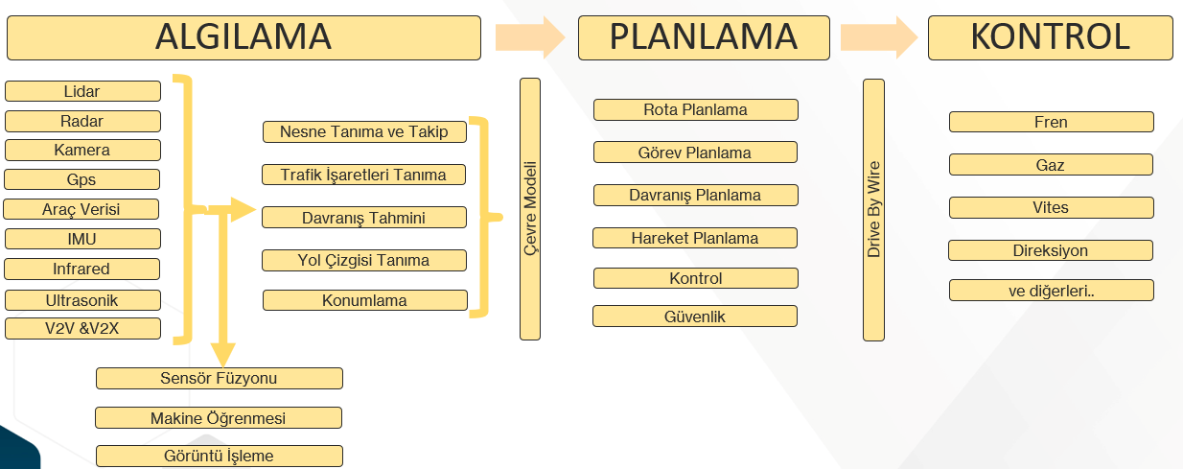
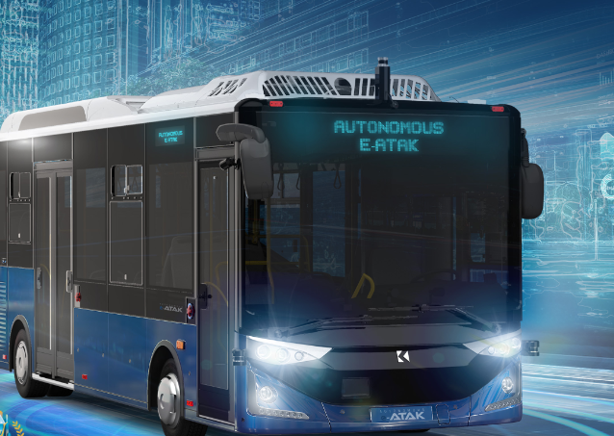

Slide 17
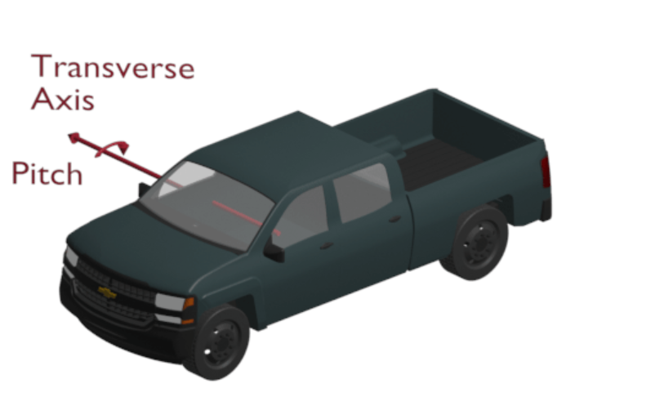
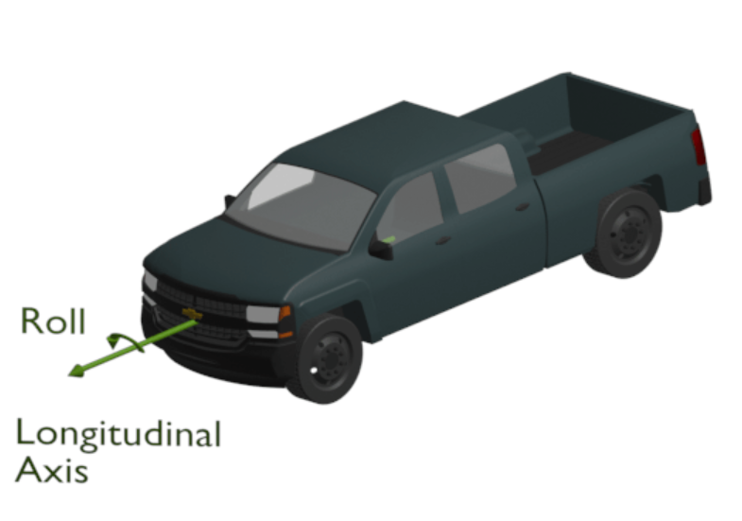
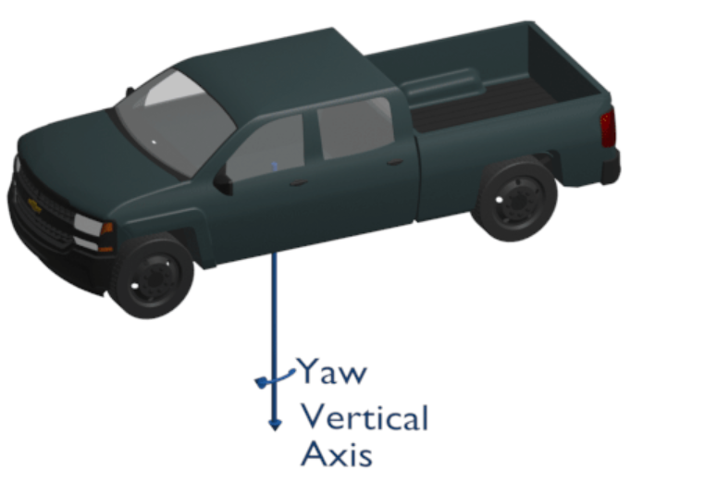
Degree of Freedom
Degrees of freedom (DOF) is the number of independent variables that define the possible positions or motions of a mechanical system in space.

Slide 18
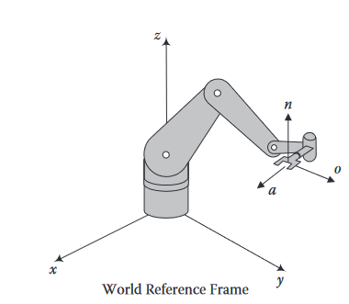
Robot reference frames
World reference frame: This is a universal coordinate frame, as defined by x-, y-, and z-axes.

Slide 19
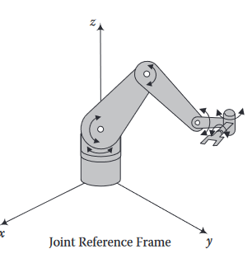
Robot reference frames
Joint reference frame: This is used to specify movements of individual joints of the robot.

Slide 20
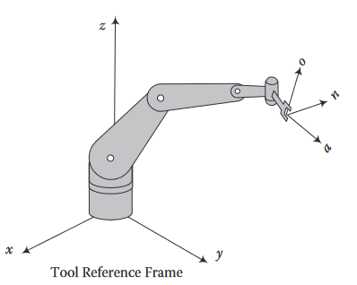
Robot reference frames
Tool reference frame: This specifies movements of the robot’s hand relative to a frame attached to the hand; consequently, all motions are relative to this local n,o,a-frame.

Slide 21
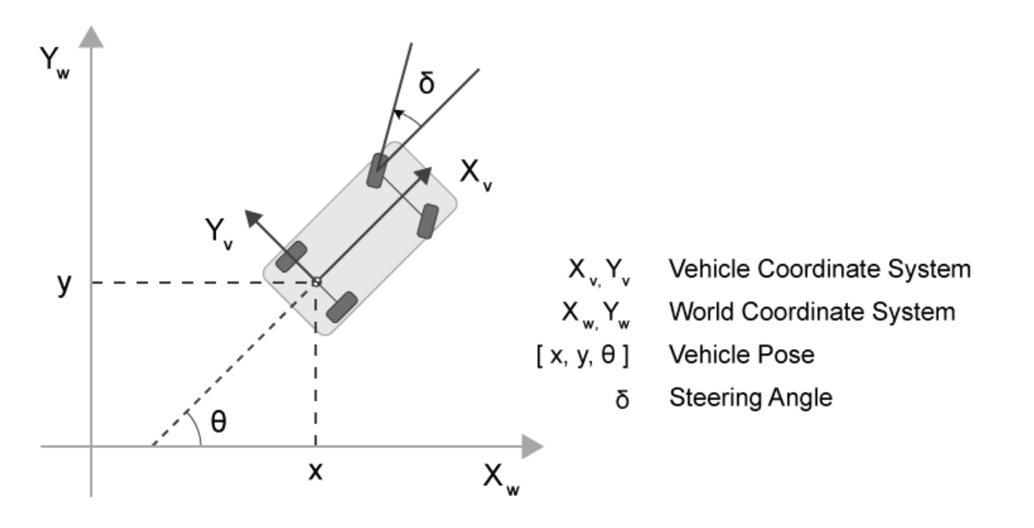
AV reference frames
Global reference frame: The global reference frame, also known as the Earth-fixed or world coordinate system, is an external coordinate system that provides an absolute frame of reference. It is typically based on global navigation systems like GNSS.
Local reference frame: The local reference frame, also known as the vehicle-centric coordinate system, is defined relative to the vehicle's own position and orientation.

Slide 22
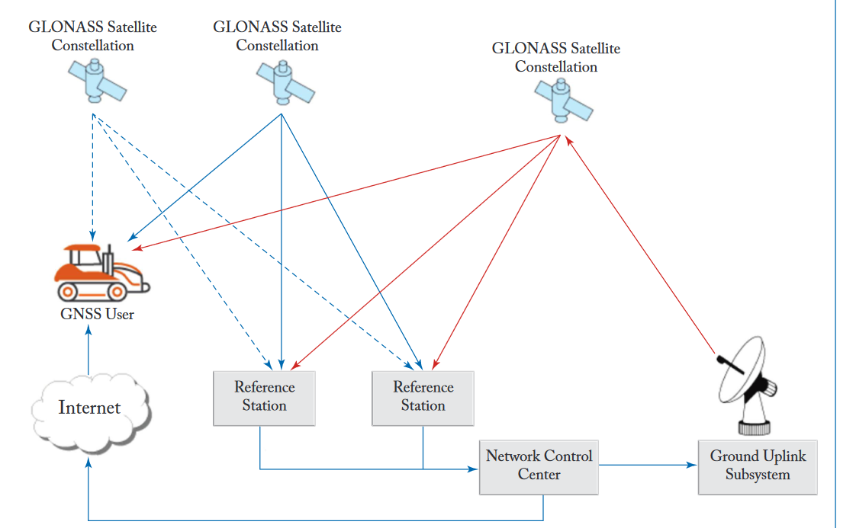
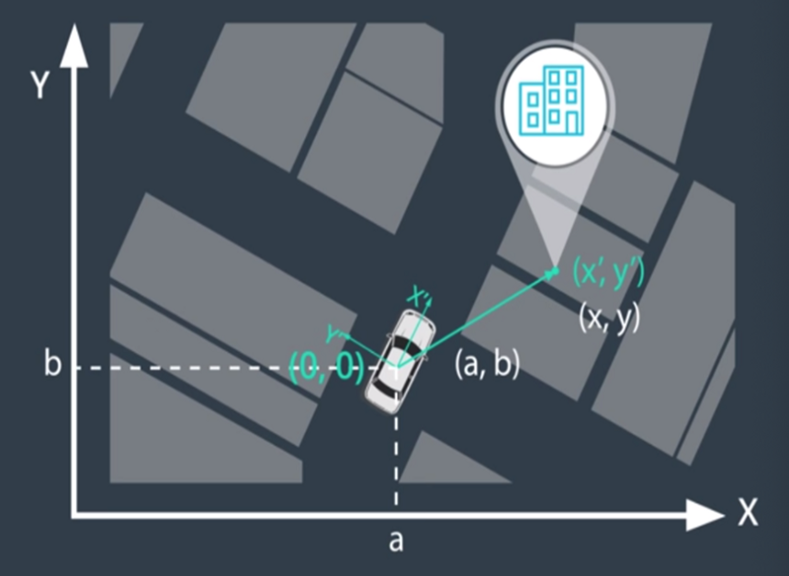
AV reference frames

